Slide 1
Digital Citizenship
William Mosier
Professor
Wright State University

Slide 2
What is Digital Citizenship?
(source: TeachThought.com)

Slide 3
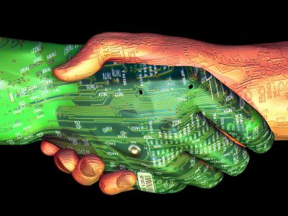
The standard of technology use considered socially competent
(source: TeachThought.com)

Slide 4
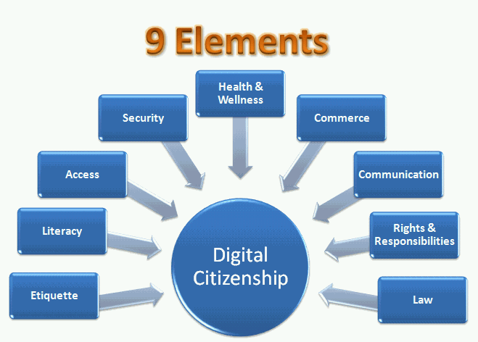
What are the Elements of Digital Citizenship?
(source: TeachThought.com

Slide 5
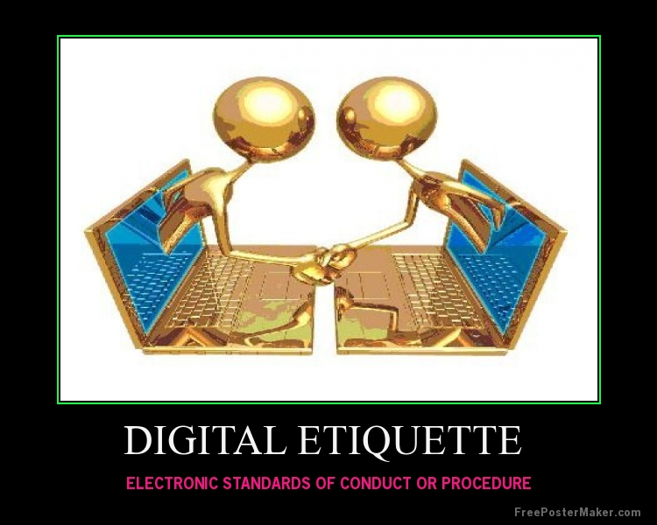
Digital Etiquette
Ribble, M. (2011). Raising a digital child. Washington, DC: International Society for Technology in Education.

Slide 6
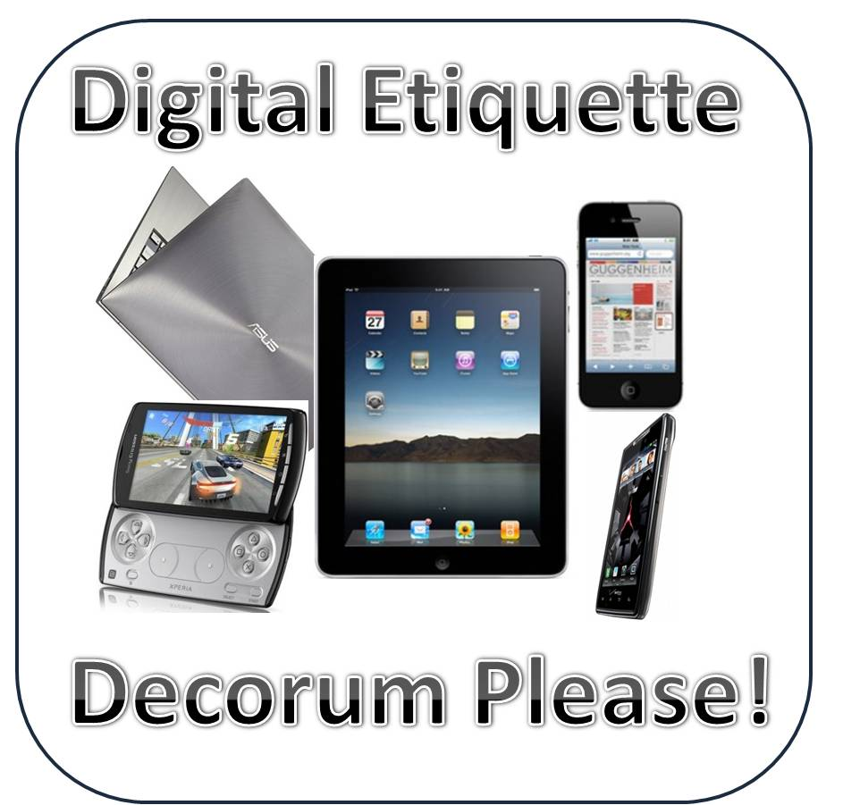
Users must learn socially competent interaction when using digital technology
Ribble, M. (2011). Raising a digital child. Washington,
DC: International Society for Technology in Education.

Slide 7
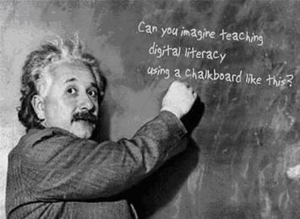
Digital Literacy
Ribble, M. (2011). Raising a digital child. Washington, DC: International Society for Technology in Education.

Slide 8
Learn how to navigate the technology
Ribble, M. (2011). Raising a digital child. Washington,
DC: International Society for Technology in Education.

Slide 9
Learn the “how to” of managing risks & understanding consequences
Ribble, M. (2011). Raising a digital child. Washington,
DC: International Society for Technology in Education.

Slide 10
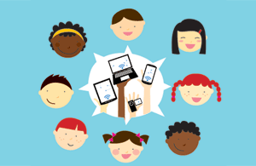
Accessibility
Ribble, M. (2011). Raising a digital child. Washington, DC: International Society for Technology in Education.

Slide 11
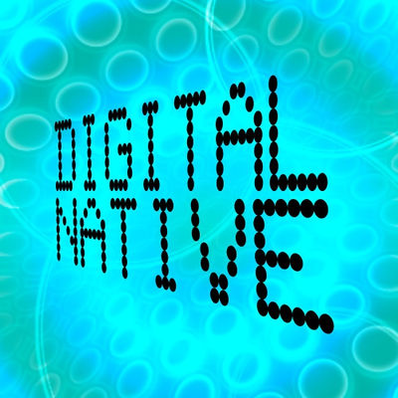
Everyone in society should have open access to digital technology as a tool for participation in society
Ribble, M. (2011). Raising a digital child. Washington, DC: International Society for Technology in Education.

Slide 12
Security
Ribble, M. (2011). Raising a digital child. Washington, DC: International Society for Technology in Education.

Slide 13
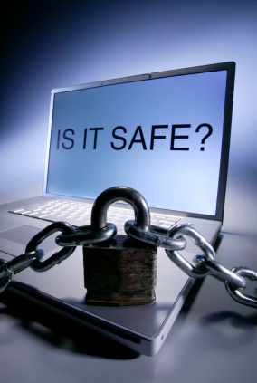
Precautions to ensure safety of personal date cannot be overemphasized
Ribble, M. (2011). Raising a digital child. Washington, DC:
International Society for Technology in Education.

Slide 14
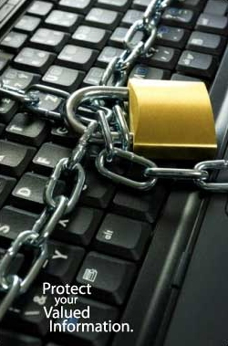
Firewall protection is essential
Ribble, M. (2011). Raising a digital child. Washington, DC:
International Society for Technology in Education.

Slide 15
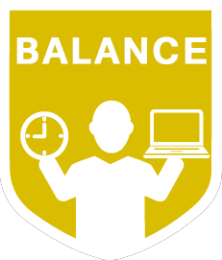
Health &Wellness is important
Ribble, M. (2011). Raising a digital child. Washington, DC: International Society for Technology in Education.

Slide 16
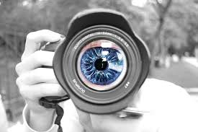
Users of digital technology must learn the potential hazards of engaging in digital technology
Ribble, M. (2011). Raising a digital child. Washington, DC:
International Society for Technology in Education.

Slide 17
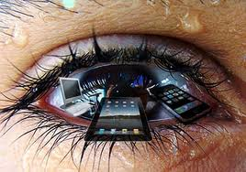
Eye strain
Ribble, M. (2011). Raising a digital child. Washington,
DC: International Society for Technology in Education.

Slide 18
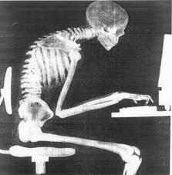
Poor posture
Ribble, M. (2011). Raising a digital child. Washington,
DC: International Society for Technology in Education.

Slide 19
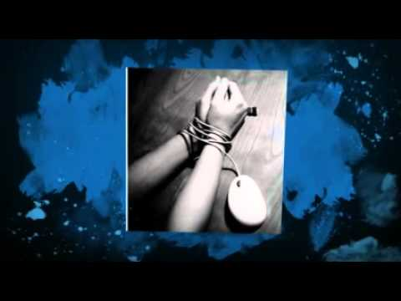
Mental health issues related to internet addiction
Ribble, M. (2011). Raising a digital child. Washington,
DC: International Society for Technology in Education.

Slide 20
Commercial Use
Ribble, M. (2011). Raising a digital child. Washington, DC: International Society for Technology in Education.

Slide 21
Buying & selling using digital technology should not include being subjected to unsolicited email, unsecure websites, & identity theft
Ribble, M. (2011). Raising a digital child. Washington,
DC: International Society for Technology in Education.

Slide 22
Digital Information Exchange (Communication)
Ribble, M. (2011). Raising a digital child. Washington, DC: International Society for Technology in Education.

Slide 23
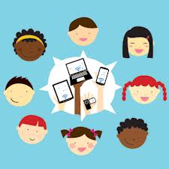
Electronic information (email, websites, cell phones, & social media) facilitates communication
Ribble, M. (2011). Raising a digital child. Washington, DC: International Society for Technology in Education.

Slide 24
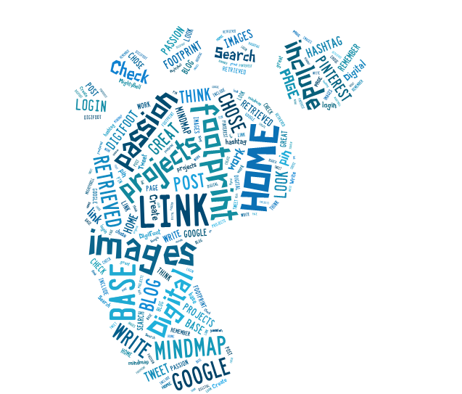
Digital Information Exchange includes responsibility to learn the “how to” of effective communication exchange
Ribble, M. (2011). Raising a digital child. Washington, DC:
International Society for Technology in Education.

Slide 25
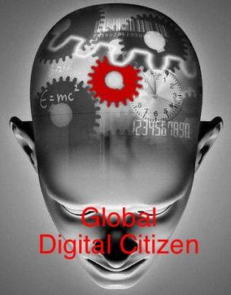
Digital Information Exchange improves social interaction & problem-solving
Ribble, M. (2011). Raising a digital child. Washington, DC:
International Society for Technology in Education.

Slide 26
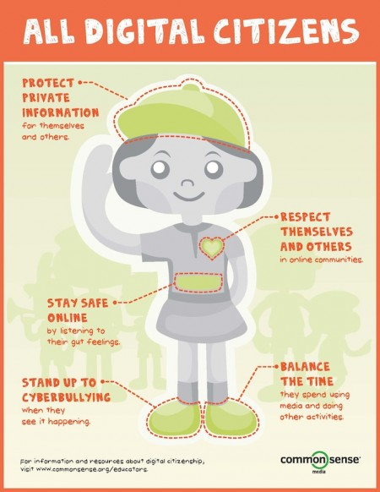
Rights & Responsibilities
Ribble, M. (2011). Raising a digital child. Washington, DC: International Society for Technology in Education.

Slide 27
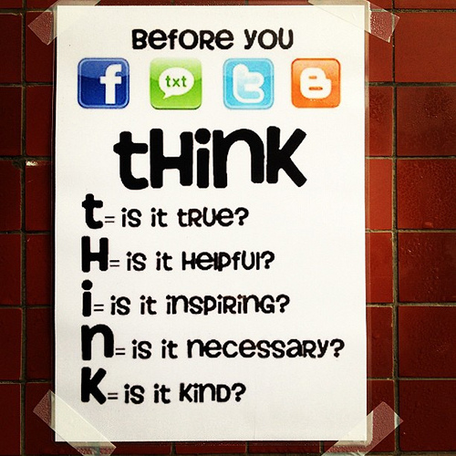
Learning the expectations included in the use of digital technology is important
Ribble, M. (2011). Raising a digital child. Washington, DC:
International Society for Technology in Education.

Slide 28
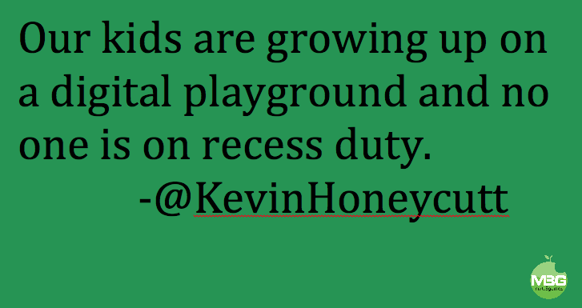
Digital Legal Rules
Ribble, M. (2011). Raising a digital child. Washington, DC: International Society for Technology in Education.

Slide 29
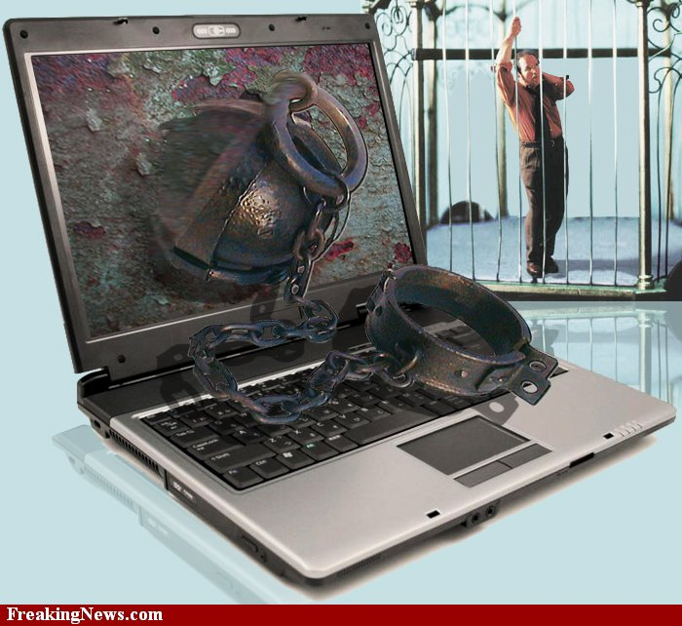
Users of digital technology must learn the responsibilities that govern its use.
Ribble, M. (2011). Raising a digital child. Washington, DC: International Society for Technology in Education.

Slide 30
Users must avoid slanderous & libelous statements & not infringe on copyright.
Ribble, M. (2011). Raising a digital child. Washington, DC: International Society for Technology in Education.

Slide 31
What is Acceptable Use Policy?
(source: TeachThought.com)

Slide 32
AUP serves as a guideline for the use of digital technology
(source: TeachThought.com)

Slide 33
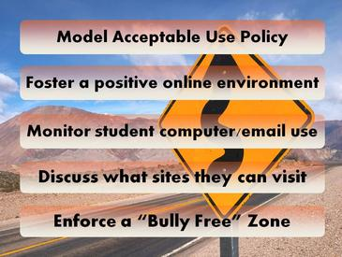
AUP includes strategies for encouraging guideline compliance

Slide 34
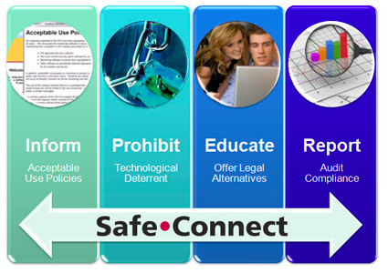
AUP provide deterrents to compliance violations

Slide 35
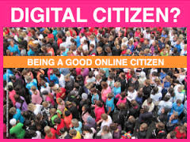
Why is Digital Citizenship Important?
(source: TeachThought.com)

Slide 36
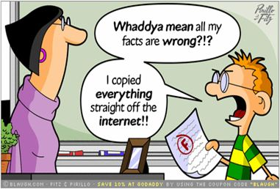
Our behavior during digital interaction can have a positive or negative impact
(source: TeachThought.com)

Slide 37
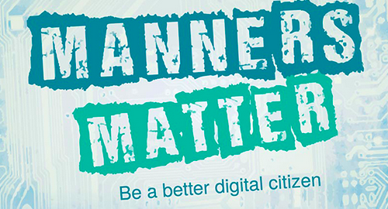
Socially responsible use of Digital Technologies is vital for ensuring it has a pro-social role.
(source: TeachThought.com)

Slide 38
Some say: “Having an AUP is not enough.”

Slide 39
To maintain a free society, having an AUP for digital technology is adequate.

Slide 40
Why is having an AUP adequate?
Ribble, M. (2011). Raising a digital child. Washington, DC: International Society for Technology in Education.

Slide 41
The key to encouraging compliance with AUP is education!
Ribble, M. (2011). Raising a digital child. Washington, DC: International Society for Technology in Education.

Slide 42
References
Kentucky Department of Education. (2014).
Every child: Proficient and prepared for
success. Education.ky.gov
Ribble, M. (2011). Raising a digital child.
Washington, DC: International Society for
Technology in Education.
TeachThought.com

